Slide 1

Generative AI for Multimedia Captions and Hashtags
Review- 2
Guide: Dr. Vairachilai. S
Name: Kabil C.A
Reg no: 23MAS10028

Slide 2
Methodology
Image caption generator is a process of recognizing the context of an image and annotating it with relevant captions using deep learning and computer vision.The imagenet dataset trains the CNN model called Xception. Xception is responsible for image feature extraction. These extracted features will be fed to the LSTM model, which generates the image caption.
Using Convolutional Neural Networks (CNN) and Recurrent Neural Networks (RNN), specifically Long Short-Term Memory (LSTM), for image detection, caption generation and enhancing these generated captions through the utilization of an open-source API, connecting to an advanced Large Language Model (LLM) like Chat GPT-4, Bard.
The goal is to make AI create better, more ethical, and more interesting captions and hashtags for multimedia content.

Slide 3
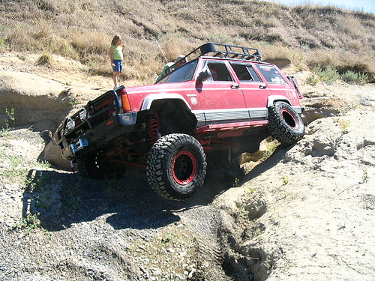
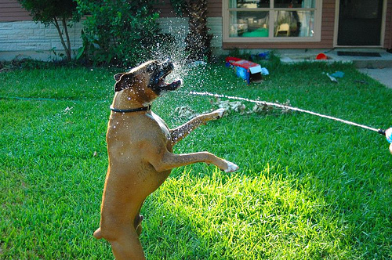
Dataset Description
The dataset collected from: Abhishek, Tarek Sherif, Nguyễn Thị Thanh Hoà
Source: Flicker
Flickr8k_Dataset: Contains a total of 8092 images in JPEG format with different shapes and sizes. Of which 6000 are used for training, 1000 for test and 1000 for development.
Flickr8k_text : Contains text files describing train_set ,test_set. Flickr8k.token.txt contains 5 captions for each image i.e. total 40460 captions.

Slide 4
Literature Survey
Title | Author(s) | Publisher | Algorithm | Inference
Apply Deep Learning-based CNN and LSTM for Visual Image Caption Generator | By N. Indumathi; R.J. Divyalakshmi; J. Stalin; V. Ramachandran; P. Rajaram. | IEEE Access Published: 2023 | CNN and LSTM | Deep Learning-based CNN and LSTM models have shown promising results in the field of Visual Image Caption Generation. These models combine Convolutional Neural Networks (CNNs) to extract visual features from images and Long Short-Term Memory (LSTM) networks to generate natural language captions.
Image Caption Generator Using Deep Learning | Palak Kabra, Mihir Gharat, Dhiraj Jha, Shailesh Sangle | Year 2022 published in IJRASET | CNN and LSTM | As a result, we can conclude that deep learning can be used to generate image captions. We can go even further by creating a hashtag generator. Based on the findings, we may conclude that the deep learning technology employed yielded positive outcomes.

Slide 5
Title | Author(s) | Publisher | Algorithm | Inference
Step by Step Guide to Build Image Caption Generator using Deep Learning | Shikha Gupta | On December 18, 2021 and Last Modified On September 5th, 2023 | CNN, LSTM | We build a deep learning model with the help of CNN and LSTM. We used a very small dataset of 8000 images to train our model, The larger the datasets are higher the accuracy. So, if you want to build a more accurate caption generator you can try this model with large datasets.
How to Develop a Deep Learning Photo Caption Generator from Scratch | Jason Brownlee | June 27, 2019 and Last Updated on December 23, 2020 | LSTM, CNN | Creating a Deep Learning Photo Caption Generator from scratch involves leveraging neural networks to comprehend and describe images, enhancing AI's ability to understand and interpret visual content
Using Machine Learning to Generate Image caption | Nouman | In Towards data science on Apr 24, 2021 | ML, CNN, LSTM | Utilizing machine learning to generate image captions enhances AI's capacity to comprehend and articulate visual content, benefiting applications in accessibility, content indexing, and human-computer interaction

Slide 6
LLM (Large Language Model):
Large language models are a specific type of ML model trained on text data to generate human-like text, and generative AI refers to the broader concept of AI systems capable of generating various types of content.
Caption Generation: LLMs excel at generating descriptive and contextually relevant captions for multimedia content. Given an image or video frame, LLMs can generate textual captions that provide a detailed and coherent description of the visual content.
Hashtag Recommendations: LLMs can recommend relevant hashtags based on the content of the multimedia. By analyzing the generated captions and recognizing key themes and concepts, LLMs suggest appropriate hashtags to enhance the discoverability of the content on social media platforms.

Slide 7
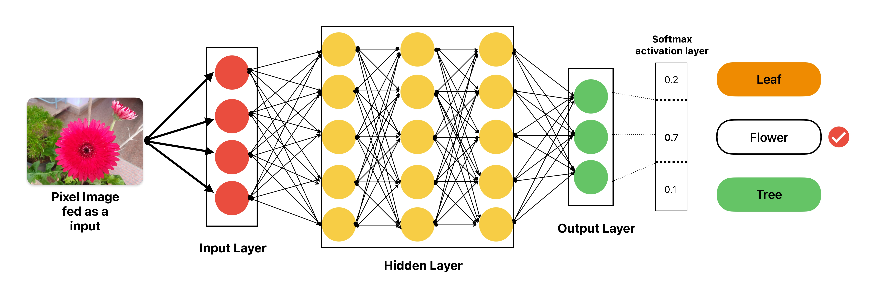
CNN:
In deep learning, a (Convolutional Neural Network (CNN/ConvNet)) is a class of deep neural networks, most commonly applied to analyze visual imagery.
Convolutional Layers: These layers are like detectives that look for specific patterns in the image.
Pooling Layers: After the detectives find patterns, the Pooling Layers come in. They shrink down the image by keeping only the most important information.
Fully Connected Layers: These layers are like the brain of the CNN. They take all the information from the previous layers and decide what the image is most likely to be. For example, they might say, "This looks like a Flower."

Slide 8
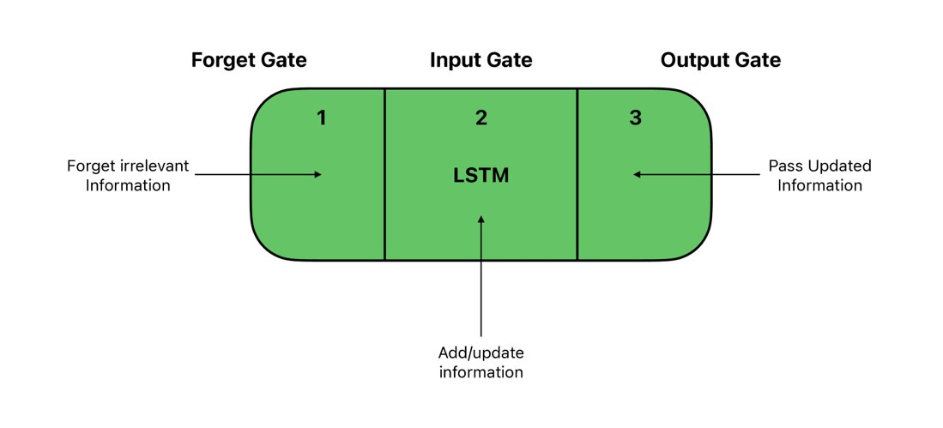
LSTM:
LSTM (Long Short-Term Memory) is like a clever robot that remembers important stuff and forgets what's not needed. It's great for understanding and making sense of sequences of information, like predicting the next word in a sentence or recognizing patterns in data over time.
LSTMs are used in things like language translation, speech recognition, and even predicting the weather because they're really good at remembering past events and using that knowledge to make smart decisions about what comes next.

Slide 9
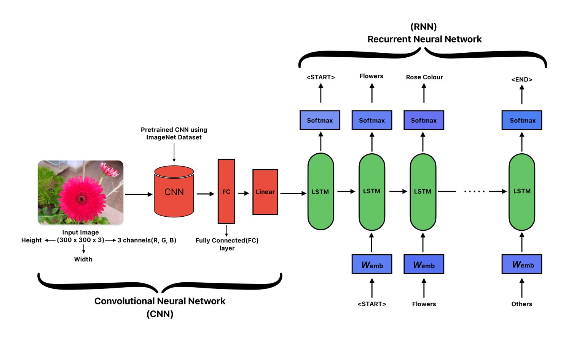
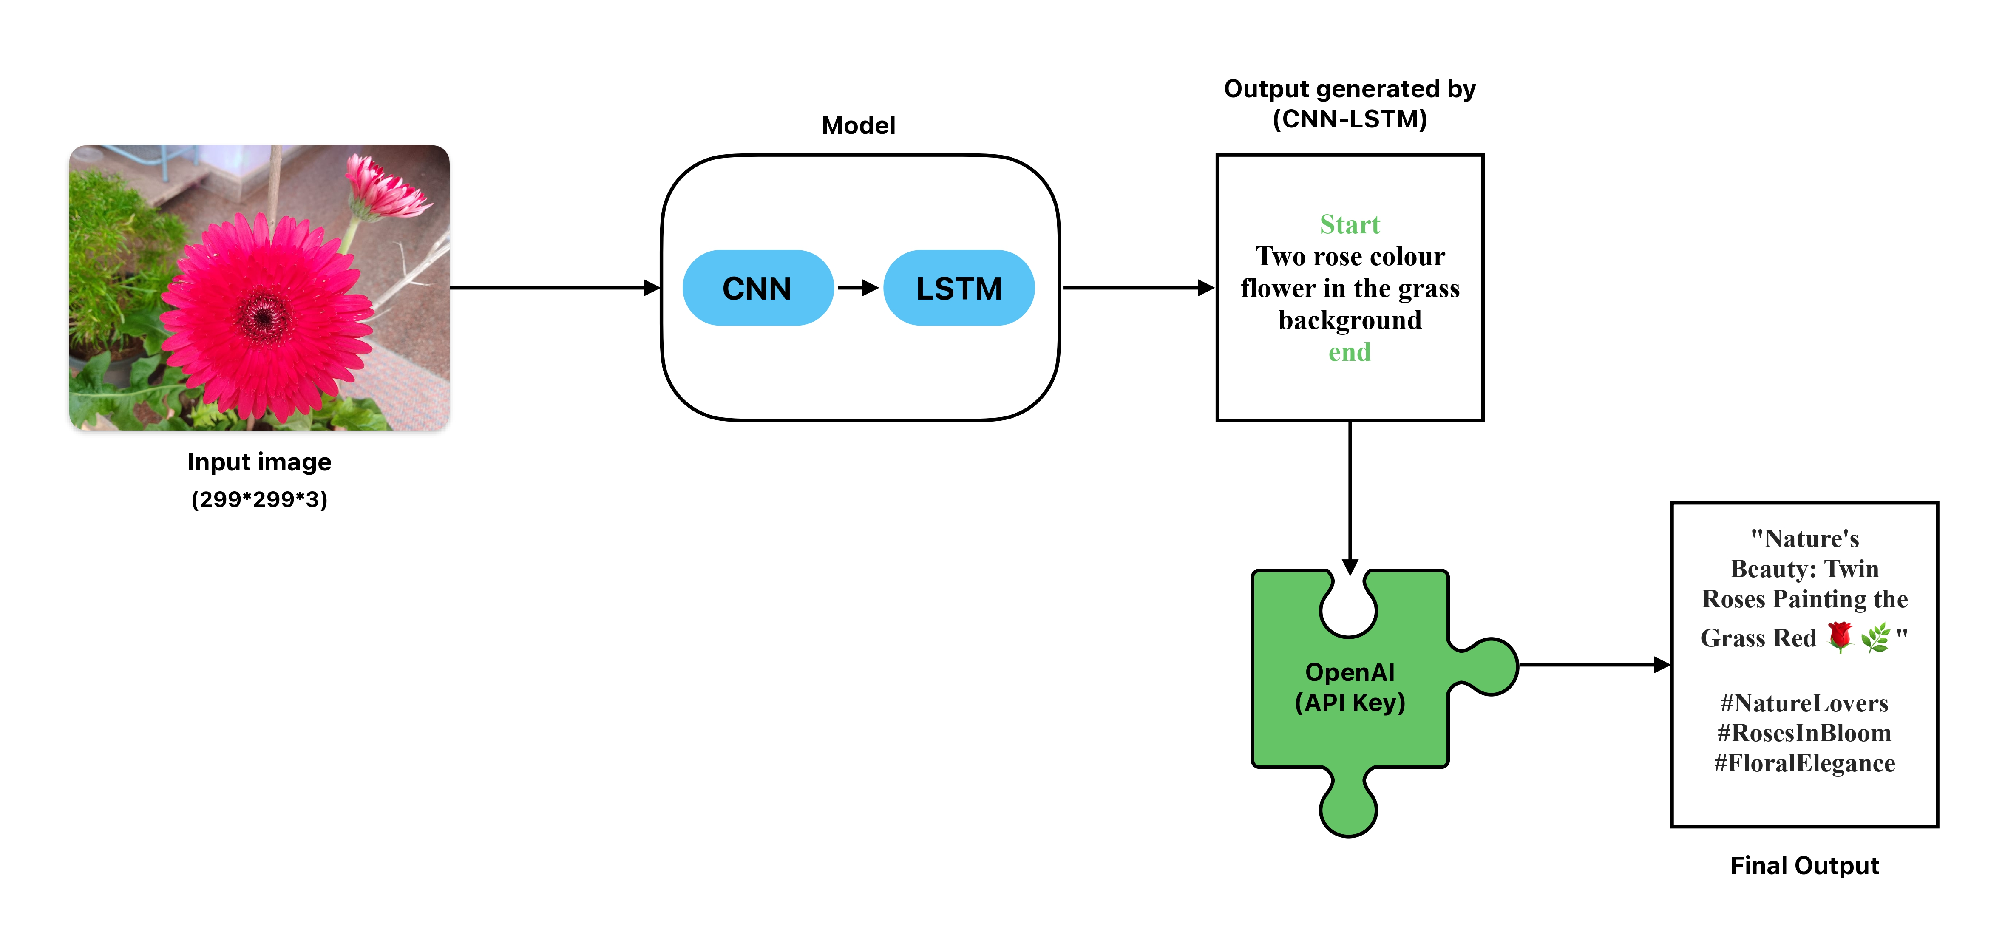
Model
Existing Model
Proposed Model*

Slide 10
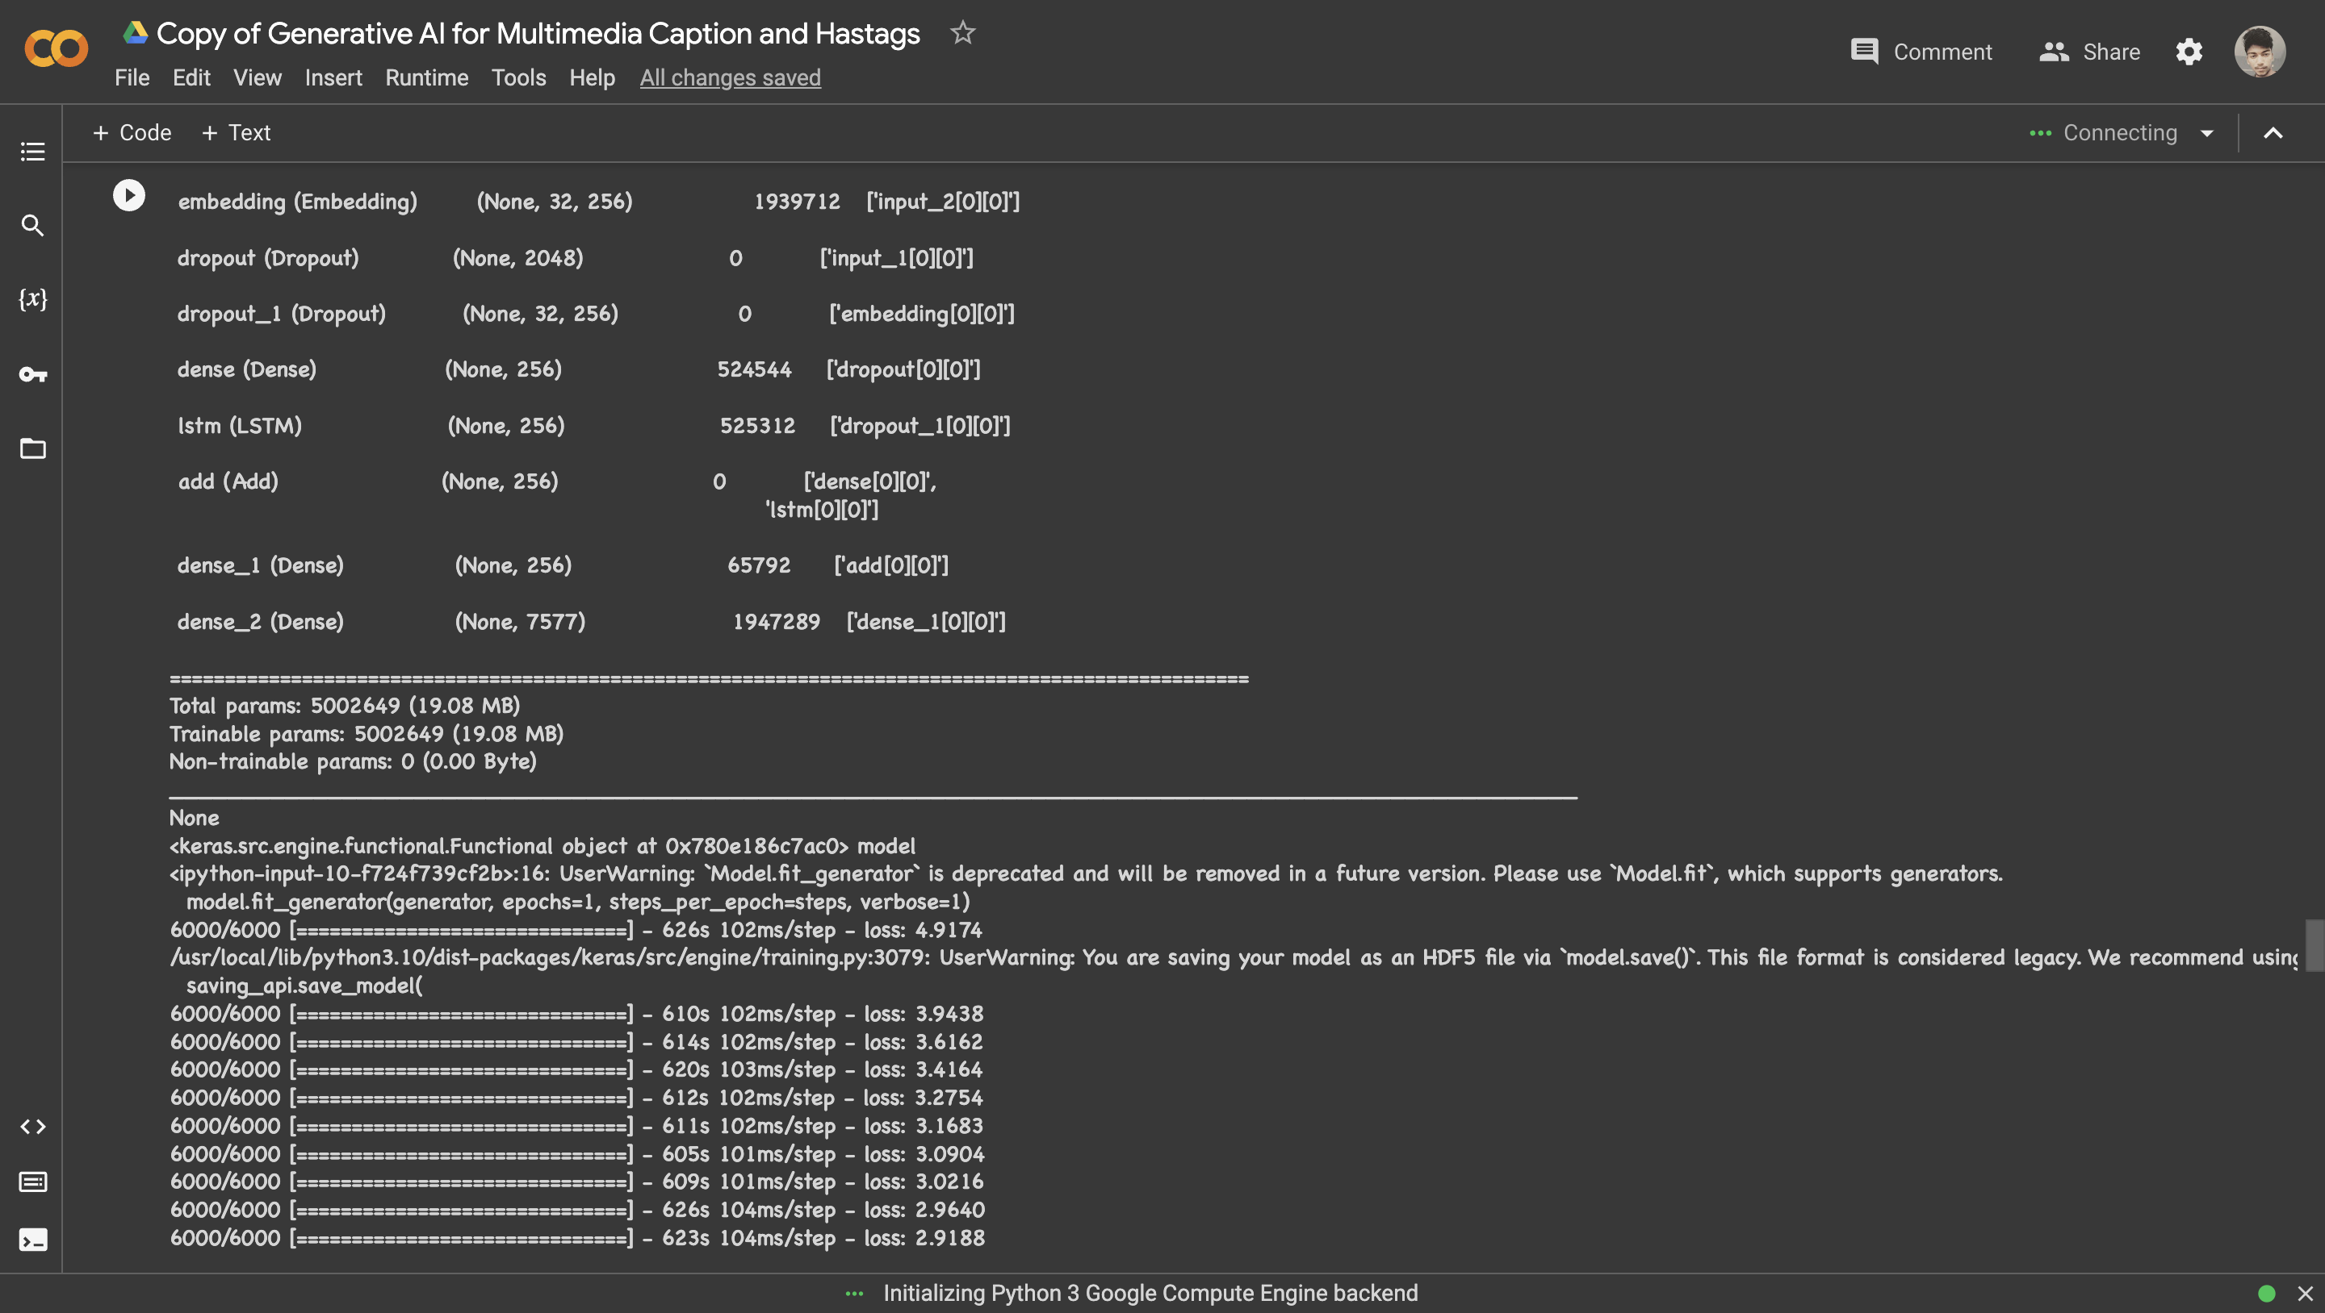
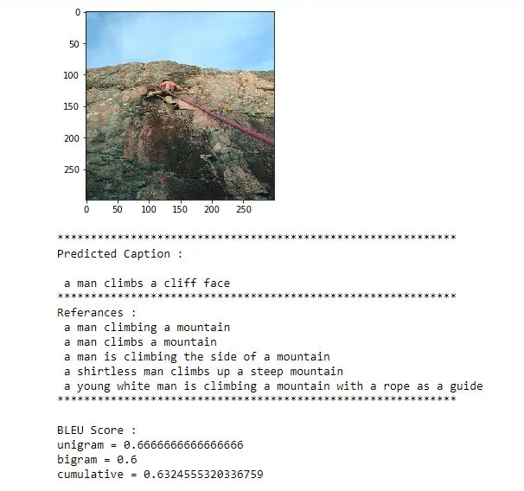
Analysis
6000/6000 [==============================] - 623s 104ms/step - loss: 2.9188

Slide 11
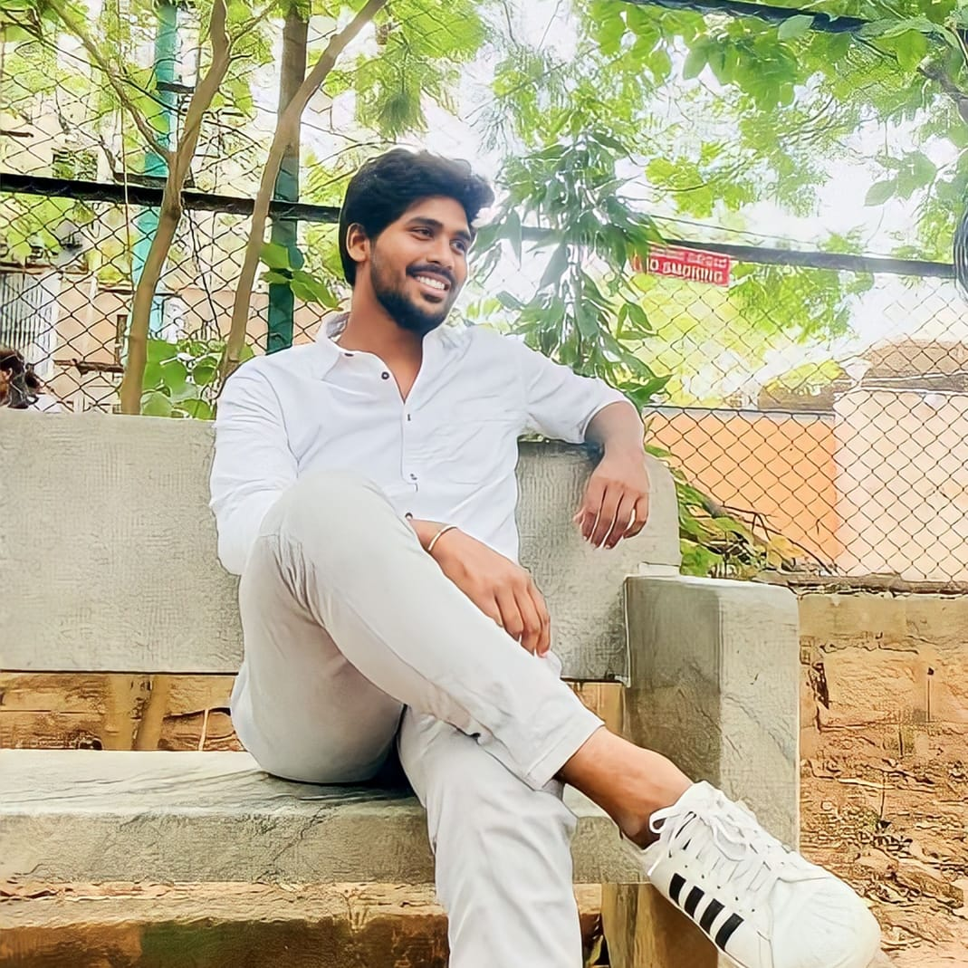

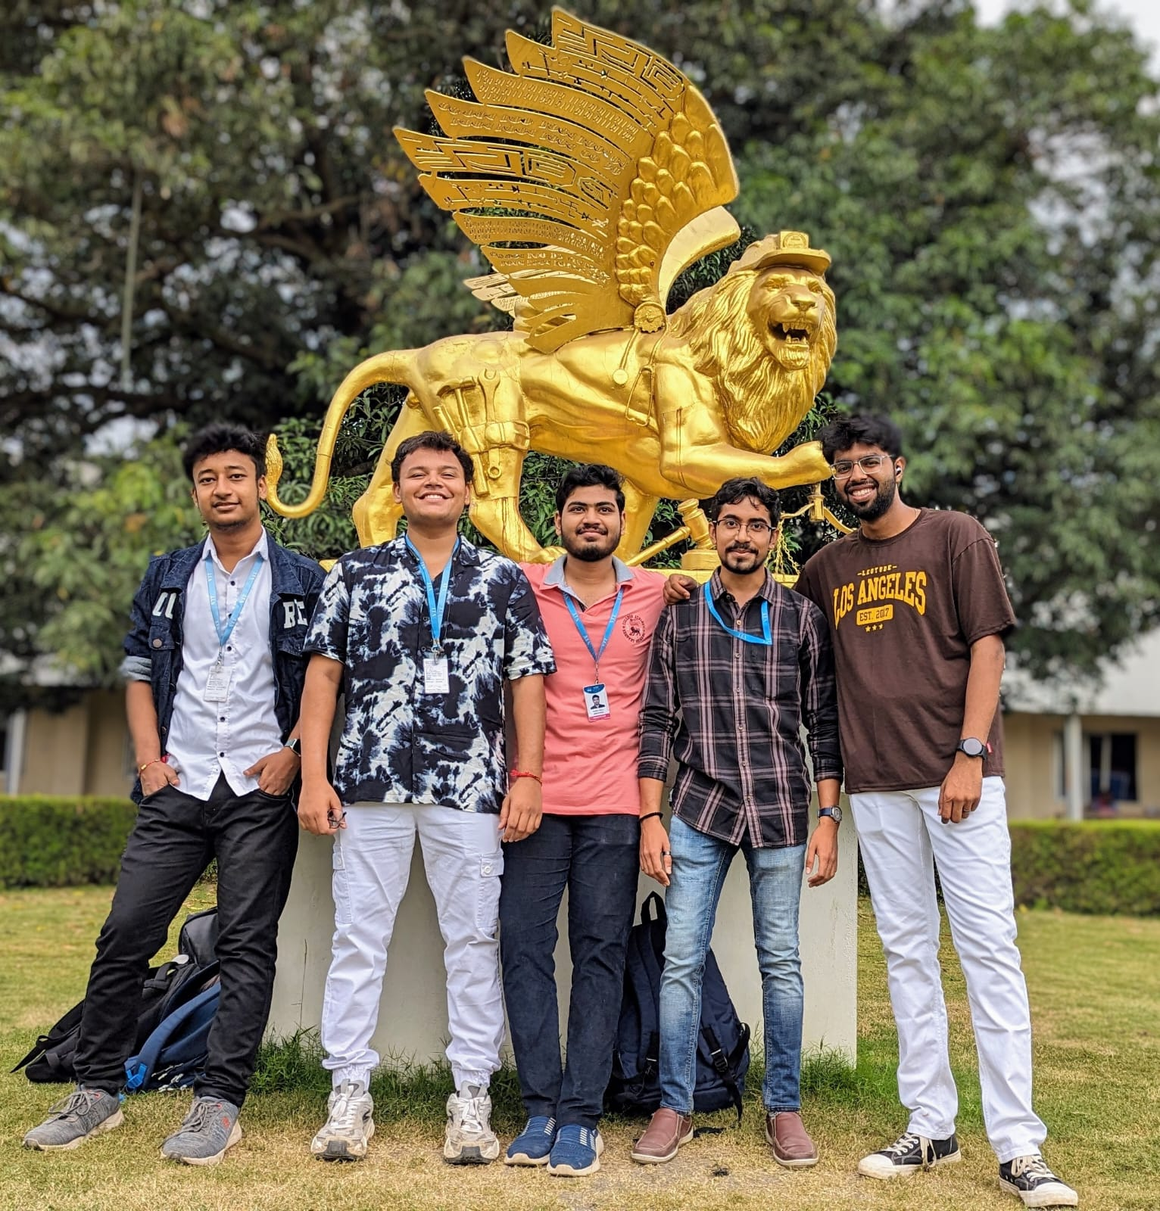
Output
Input | CNN and LSTM | LLM
#1 | Start of man is enjoying the street love mountain background and laugh end | Caption: Embracing love and unity on the streets ⚡️ Hashtags: #EmbraceLife #StreetBonds #LoveandUnity
#2 | Start of people walking in ocean end enjoying in bright sun day end | Caption: Enjoying a peaceful stroll along the ocean's edge 🌊 Hashtags: #CoastalVibes #OceanLove #Sunny day
#3 | Start of people playing wrestling game in front of building with their arms around each other in the grass end | Captions: Fun times at the wrestling game with friends! Hashtags: #friends #outdoorfun #teamwork

Slide 12
Reference
"Deep Learning-Based Short Story Generation for an Image Using the Encoder-Decoder Structure" (published on August 12, 2021, with the current version dated August 19, 2021, authored by KYUNGBOK MIN, MINH DANG, HYEONJOON MOON).
"Image Caption Generator" by Megha J Panicker, Vikas Upadhayay, Gunjan Sethi, and Vrinda Mathur (published in January 2020).
"Step by Step Guide to Build Image Caption Generator using Deep Learning" by Shikha Gupta (published on December 18, 2021, and last modified on September 5th, 2023).
"Image Caption Generating Deep Learning Model" by Aishwarya Maroju, Sneha Sri Doma, and Lahari Chandarlapati, published on September 20, 2021
Image Caption Generator using Deep Learning - Published On 2020 2nd International Conference on Advances in Computing, Communication Control and Networking - by M. Sailaja; K. Harika; B. Sridhar; Rajan Singh; V. Charitha; Koppula Srinivas Rao
"A large-scale study of user engagement with political hashtags" by Diakopoulos et al. (2016) - This study explores user engagement with political hashtags on Twitter, shedding light on the significance of hashtags.
"GPT-3: Building Innovative NLP Products Using Large Language Models" - Sandra Kublik, Shubham Saboo - O'Reilly Media, Year: 2022
“A Comprehensive Survey of Deep Learning for Image Captioning” - date publication 04 February 2019 - by MD. Zakir Hossain, Ferdous Sohel, Mohd Fairuz Shiratuddin, Hamid Laga
“Evolving Deep Neural Networks” - date of publication 2 November 2018 - by Risto Miikkulainen, Jason Liang, Elliot Meyerson, Aditya Rawal, Daniel Fink, Olivier Francon, Bala Raju, Hormoz Shahrzad, Arshak Navruzyan, Nigel Duffy, Babak Hodjat.
“Apply Deep Learning-based CNN and LSTM for Visual Image Caption Generator” - IEEE Access Published: 2023 – By N. Indumathi; R.J. Divyalakshmi; J. Stalin; V. Ramachandran; P. Rajaram.

Slide 13

Thank You !

